Slide 1
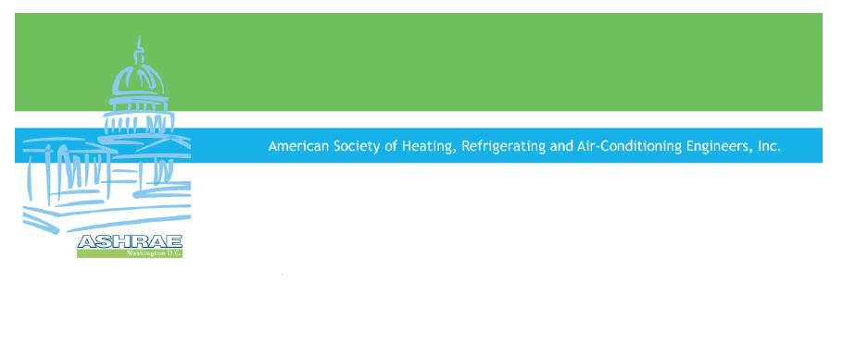

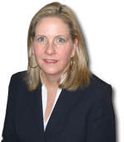

ASHRAE
Government Affairs:
Technical Expertise to Policymakers
Presentation to ASHRAE Atlanta Chapter
February 8, 2011
Doug Read, Program Director, Gov’t Affairs
ASHRAE Washington Office
1828 L Street, NW
Suite 906
Washington, DC 20036
202-833-1830
www.ashrae.org/advocacy
Patricia Ryan, Assistant to the Director, Washington Office
Mark Ames, Manager, Gov’t Affairs

Slide 2
Federal Requirements and
Laws to Know

Slide 3
Federal Requirements
Commercial Buildings
(Title III of Energy Conservation and Production Act)
ANSI/ASHRAE/IESNA 90.1
  States must certify that their comm. building code meets/exceeds the newest version of 90.1
  States have 2 years to certify
  Incentive funding is provided to states for adoption of such codes, but…
  There is no mechanism for enforcement of these provisions if states do not comply
  As a result states vary widely in their adoption of 90.1, as shown by the following map

Slide 4
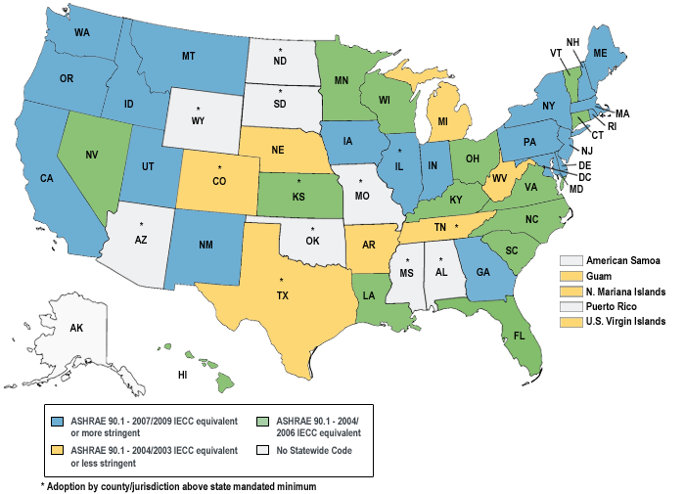
Current State Adoptions of 90.1
as of January 5, 2011
Notes:
About 20 states have adopted 90.1-2007, the 2009 IECC equivalent or a more stringent standard. But you can see that over half the states and territories have adopted a less stringent standard, and that several states and territories have no statewide code at all.
Why is this bad? It makes it harder for companies to do business across state lines – you can see from the map that several states that have adopted 90.1-2007 or a more stringent standard, are bordered by states that have adopted less stringent standards.
There are more reasons than this, but the economic reason alone is pretty compelling.

Slide 5
Federal Requirements
Federal Buildings
(Energy Independence and Security Act of 2007)
Federal buildings must be designed so fossil fuel-generated energy consumption of the building is reduced as compared to CBECS by:
2010 ............... 55%
2015 ............... 65%
2020 ............... 80%
2025 ............... 90%
2030 ............... 100%

Slide 6
ARRA
American Recovery and Reinvestment Act (ARRA), Sec. 410
As a condition of receiving some State Energy Program funds under ARRA, states and local governments are require to implement a building energy code for commercial buildings that meets or exceeds 90.1-2007 and develop a plan to achieve compliance with the code within 8 years in at least 90% of new and renovated space.
What’s going on now?
All 50 states have provided certification that they will comply with these requirements.

Slide 7
ARRA
The Department of Energy's Building Energy Codes project (BEC) released a Request for Proposals in August, 2010, for states and territories for activities related to the adoption of and compliance with the most current building energy codes. The primary purpose is to advance state building energy codes to the efficiency levels in today's model codes.
A total of $7 million has been awarded to 24 states:
Alabama Idaho Massachusetts Montana New Mexico
Utah Arizona Illinois Michigan Nebraska North Carolina
Virginia Colorado Kentucky Mississippi Nevada South
Carolina Washington Georgia Maine Missouri New Jersey
Texas Wisconsin
All activities will be completed by June 30, 2011. Results of the projects will be made available publicly.

Slide 8
Federal Buildings Personnel Training Act
New Federal Law! ASHRAE helped lead a coalition of technical societies in support of this bill.
Introduced by Representatives Carnahan (D-MO), Biggert (R-IL), and Norton (D-DC), and Senators Carper (D-DE) and Collins (R-ME)
Requires the General Service Administration (GSA) to identify the core competencies necessary for federal personnel performing building operations and maintenance, energy management, sustainability, water efficiency, safety, and building performance measures
Requires the GSA to work with relevant professional societies, industry associations, and others to develop a recommended curriculum relating to facility management and the operation of high-performance buildings

Slide 9
Federal Buildings Personnel Training Act (cont.)
Requires GSA to work with relevant professional societies, industry associations, and others to develop a course, certification, degree, license, or registration to demonstrate each core competency, and for ongoing training
Requires relevant federal personnel to demonstrate competency in the core areas through certification, licensure, etc.
Requirements of this bill would apply to non-federal personal performing building operations and maintenance, energy management, safety, and design functions under a contract with a federal department or agency

Slide 10
Federal Energy Legislation to Know from the Last (111th) Congress

Slide 11
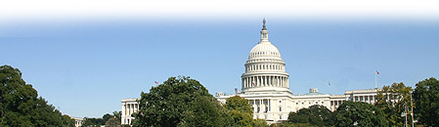
Federal Energy Legislation (111th Congress)
H.R.2454 American Clean Energy and Security Act (Rep. Waxman, D-CA; Rep. Markey, D-MA)
S.1462 American Clean Energy Leadership Act (Sen. Bingaman, D-NM)
30% Reduction in Energy by 2010
50% Reduction in Energy by 2016 Residential & Commercial
75% Reduction in Energy by 2021
S.3464 Practical Energy & Climate Plan (Sen. Lugar, R-IN)
30% Reduction in Energy by 2012
50% Reduction in Energy by 2015 (Residential), by 2017 (Commercial)

Slide 12
Election Results

Slide 13
Election Results
House of Representatives
Republicans took control, gaining 66 seats.
Senate
Democrats retained control, but lost 6 seats to Republicans.
Governorship
Republicans won the governorship in 23 states, increasing their
numbers to 29 states, for a net gain of 6.

Slide 14
What do the elections mean to us?
Educational opportunities and the chance to affect policy decisions on a broad scale…

Slide 15
Where Will Most of the Action Be in 2011?

Slide 16
In the Federal Agencies and at the State and Local Levels…
There will be gridlock in Congress, but the agencies
don’t have that problem…
Federal agencies issues thousands of regulations
each year, all carry the force of law
In 2010 alone, agencies took action on a wide
variety of issues:
  Smart Grid
  Building Energy Efficiency
  Building Rating Systems
  The list goes on…
Lots of activity likely at the state & local levels as well = ample opportunities for chapter involvement

Slide 17
Advocacy at the chapter level is encouraged.
Chapters may reference previous ASHRAE positions, statements, documents, etc.
Chapters may not speak on behalf of ASHRAE.
Please consult Doug Read or Mark Ames for more information.

Slide 18
DOE Top Priorities

Slide 19
DOE’s Top Priorities
High Impact Innovation
Speed & Scale
Attracting the Best Talent
Capturing Hearts & Minds for Energy Efficiency & Low-Carbon Technologies

Slide 20
ASHRAE’s Advocacy Priorities

Slide 21
Advocacy Priorities
Energy Efficiency
Climate Change
Indoor Environmental Quality
Water Conservation
STEM Education/Competitiveness

Slide 22
ASHRAE DC Office 2010 Activities
Specific information on DC Office activities is available from Doug Read and Mark Ames upon request (contact info at the end of this presentation). In general, DC Office activities fall into the following categories:
  Participation in Coalitions
  Workshops/Symposia
  DOE Fellowship
  Internship
  Advocacy-Congress, Federal Agencies, the White House
  Other Government Affairs Activities

Slide 23
Participation in Coalitions
High Performance Building Congressional Caucus Coalition (ask your representative to join)
  Secretariat
  Monthly Briefings
  Federal Building Legislation
NIBS Consultative Council
  Doug Read Chairs the Council
  Draft Report on Codes & Standards
Energy Code Enforcement Funding Task Force
  Weekly Meetings
  Policy Maker Fact Sheet Released
Zero-Energy Commercial Building Consortium (www.zeroenergycbc.org)
  Response to EISA Sec. 421/422
  Steering Committee Member
  CBC Report Released

Slide 24
Participation in Coalitions
  Building Community Ad Hocs (climate change, building codes, depreciation, tax credits, federal buildings)
  HVAC Alliance (ACCA, AHRI, HARDI, PHCC)
  Commercial Building Tax Deduction Coalition
  Code Adoption and Enforcement (NASEO, ICC, ASE, BCAP)

Slide 25
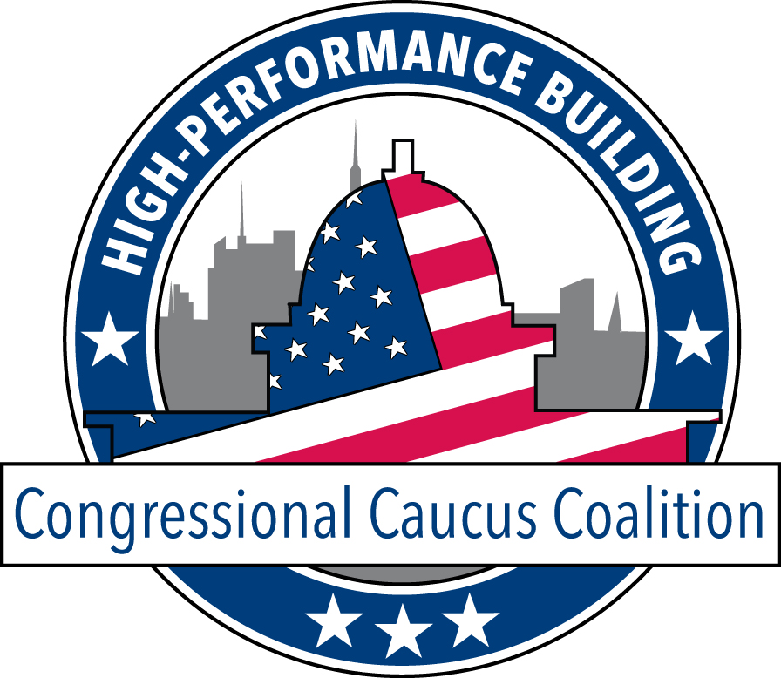

Slide 26






















High-Performance Building Congressional Caucus
Co-Chairs
Russ Carnahan (D-MO)
Judy Biggert (R-IL)
Members
Supporting Coalition Includes
Tammy Baldwin (D-WI)
Earl Blumenauer (D-OR)
Robert Brady (D-PA)
Ben Chandler (D-KY)
Mike Doyle (D-PA)
David Dreier (R-CA)
Vernon Ehlers (R-MI)
Bill Foster (D-IL)
Gabrielle Giffords (D-AZ)
Debbie Halvorson (D-IL)
Paul Hodes (D-NH)
Jay Inslee (D-WA)
Steve Kagen (D-WI)
Dennis Kucinich (D-OH)
Dan Lipinski (D-IL)
Dave Loebsack (D-IA)
Zoe Lofgren (D-CA)
Doris Matsui (D-CA)
Betty McCollum (D-MN)
Jim McDermott (D-WA)
Mike McIntyre (D-NC)
Jerry McNerney (D-CA)
Ed Perlmutter (D-CO)
Todd Platts (R-PA)
Allyson Schwartz (D-PA)
Joe Sestak (D-PA)
Edolphus Towns (D-NY)
David Wu (D-OR)
http://www.hpbccc.org

Slide 27
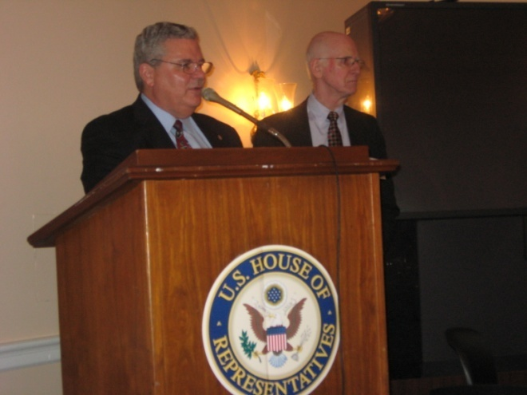
Workshops/Symposia/Meetings
Capitol Hill Briefings (HPBCCC)
Building Metrics: Understanding Performance & Making
Informed Choices (December 14, 2010)
Saving Water in the Interior of a Building (September 13, 2010)
High Performance Building Isn’t Just the Building (July 12, 2010)
The Zero Energy Commercial Building Consortium (June 18, 2010)
Getting the Whole Picture of High-Performance Buildings (June 15, 2010)
Building STAR Legislation: Retrofitting Our Way to Energy
Savings and Job Creation (May 24, 2010)
What’s Your Quality of Light? Sustainable Solutions for
Human Needs and Energy Efficiency (April 29, 2010)
ASHRAE Presidential Meetings
    Sept. 2010: The White House, NASEO, EPA, AHRI, DOE, USGBC, ASE, NEMA, FEMP

Slide 28
Workshops/Symposia/Meetings
  NIST/BFRL Workshop on International Engagement
  Rebuilding America
  AGC Meeting on Construction and Climate Change
  NAE Symposium on K-12 Engineering Education
  NEMA Energy Tax Coalition
  IFMA/FFC Policy Forum
  Interagency Sustainability Working Group
  ACEEE Briefing on Behaviors for Energy Efficiency
  Minnesota Energy Expo
  Interagency Council on Indoor Air Quality
  USGBC Building Performance Initiative Discussion
  EPA/DOE Discussion on Energy Star MOU
  DHS Summit on Security, Energy and Environment
  Energy Policy Alliance

Slide 29
Advocacy
Development of letters, comments & testimony to Congress and Agencies on pending actions
  ARRA and Code Adoptions
  STEM Education
  Commercial Building Tax Deduction
  EIA Funding
  Depreciation of HVAC&R Equipment
  Setting Commercial Equipment Efficiency Standards
  Building Codes
  Federal Building Efficiency Standards
  Smart Grid Interoperability Standards
  School Modernization

Slide 30

Additional Washington Office Activities
  Building Energy Quotient Program
    www.buildingeq.com
  Building Code Adoptions
    Standard 90.1
    Standard 189.1
  Empowering Chapters to Engage State and Local Policymakers

Slide 31
Advocacy Tools
One-page non-technical policy briefs/leave-behinds
  Based on existing ASHRAE Position Statements
  Developed through Advocacy Committee with technical review and approval by ExCom
    Energy Efficiency
    Climate Change
    STEM Education
    Federal R&D Funding
    Standards
    Building Energy Data

Slide 32
Advocacy Tools
  Government Affairs Updates
    Bi-weekly e-mails featuring government activities of interest
    Sign up at http://www.ashrae.org/advocacy
  Advocacy Packets
    Additional licensure requirements
    State TTAA
    Building Codes
    Stimulus Funds (www.ashrae.org/recovery)
    Building Energy Labeling

Slide 33
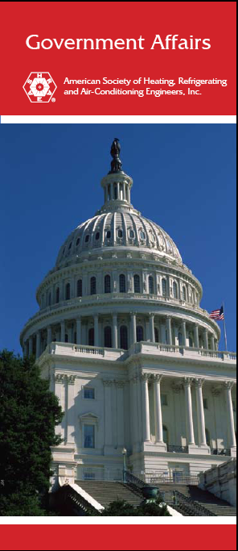
Advocacy Tools
  Chapter Public Policy Materials
    CTTC/Washington Office Primer on Government Activities
      Accompanying PowerPoint Presentation
    Advocacy Toolkit
      http://www.ashrae.org/advocacy/page/1262
  Government Affairs Brochure
    Activities of the ASHRAE Washington Office
    Available as PDF for distribution to chapter members

Slide 34
Advocacy Tools
  ASHRAE’s new policy requests and recommendations document for the 112th Congress

Slide 35
Opportunities for Individual Member Participation
  Engineering R&D Symposium
  ASHRAE Congressional Briefings
  Forthcoming programs
    Washington Visitation Program
    CTTC Chair Training Programs
  HPBCCC Congressional Visits Days
  Washington Fellowship
  WISE Program
    ASHRAE Chairs Steering Committee

Slide 36
Opportunities for Individual Member Participation
  Contact State and Local Policymakers on Important Issues
    Building Energy Codes
    NCEES Masters or Equivalent
    Stimulus Funds
    Building Energy Disclosure
    Use of Voluntary Consensus Standards

Slide 37
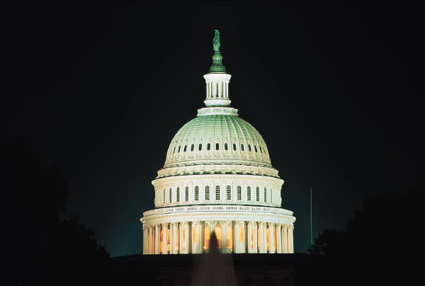
ASHRAE/DOE Fellowship
  2008-2011 Fellow Mike Erbesfeld began in Sen. Dianne Feinstein’s Office, moved to DOE in May 2009
  Currently seeking fellows for placement at DOE on codes issues
  Funding provided by DOE

Slide 38

Internship
  Washington Internship for Students of Engineering (WISE)
    Summer Internship in Washington, DC for third year engineering students
    Explore nexus of engineering and public policy
    Lodging and stipend included
  Summer 2010 intern, Ramsey Brown, California Maritime Academy

Slide 39
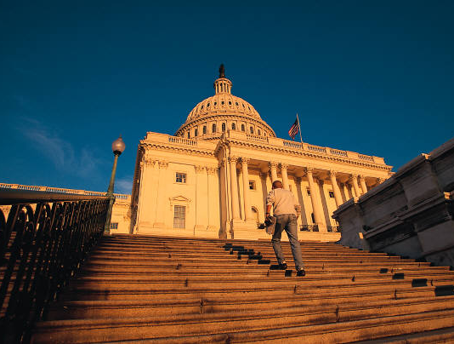

Government Activities and ASHRAE Chapters
This Can Be You!

Slide 40
Government Activities and ASHRAE Chapters
What are some of the benefits of participating in government affairs?
Become a part of something bigger
Establish relationships with key decision-makers
Make yourself more valuable to your company by becoming knowledgeable in the current and future trends & issues that will affect your industry

Slide 41
Government Activities and ASHRAE Chapters (cont.)
How can chapters get more involved?
Encourage chapters to identify leaders for advocacy who will coordinate and help organize each chapter’s advocacy efforts
Make a plan, set goals, track progress, talk with other ASHRAE chapters, and review your plan annually
  Don’t be afraid of mid-course corrections
Meet with ASHRAE Washington, DC Office Staff for guidance, support, and ideas

Slide 42
Any Questions?
Doug Read, dread@ashrae.org
and
Mark Ames, mames@ashrae.org
Both by phone at 202-833-1830

